Slide 1

Medical Image Fusion Using Deep Learning
Mentor
Dr. Manoj Diwakar
Associate Professor
Submitted By
Ayush Kumar
2016692

Slide 2
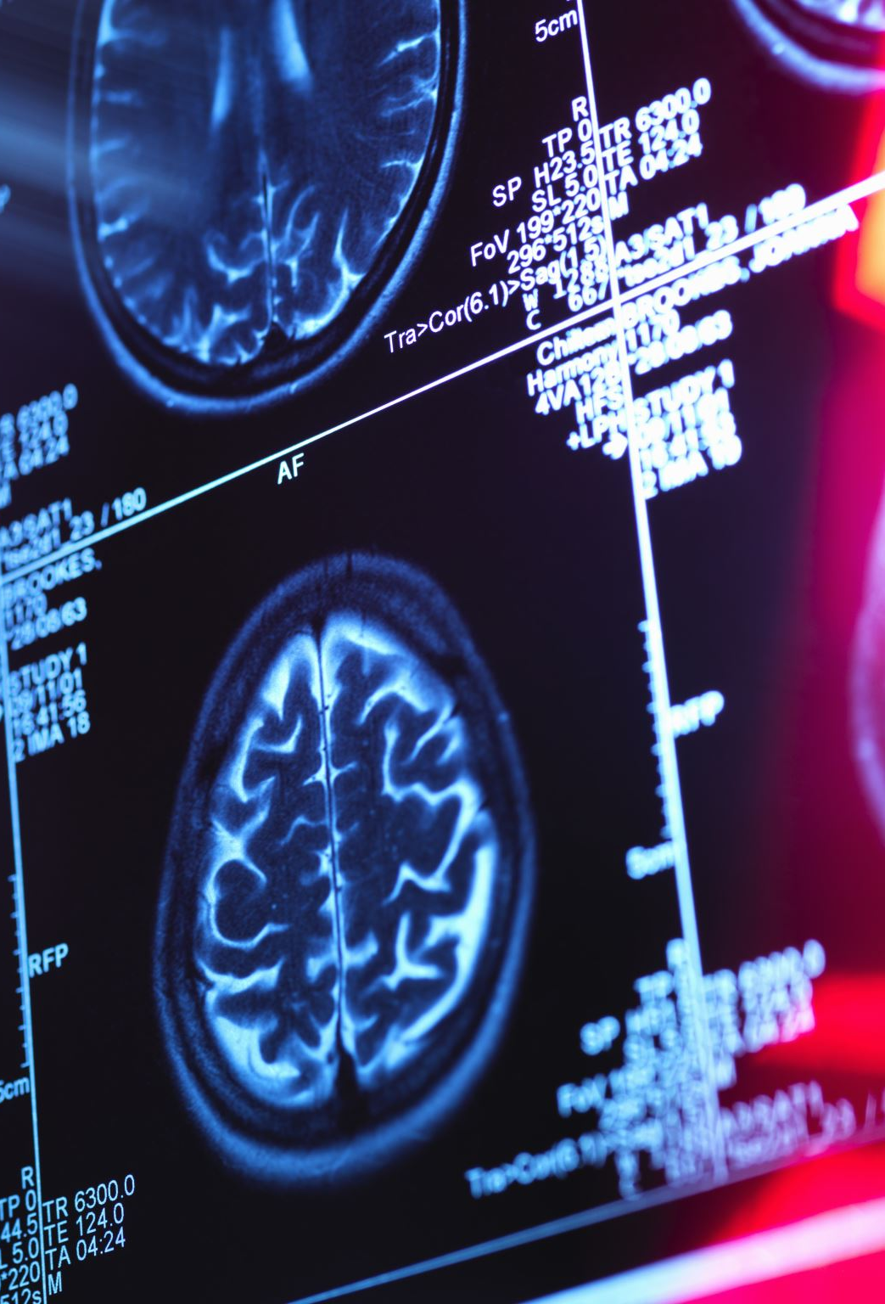
Introduction
Medical Image fusion is one of the best techniques which helps medical science to grow more better. By fusing different images like CT, MRI etc., we can have exact structure of the part of the organ. This will help us in avoiding overlooking of different medical image while treating patients, the doctor will have a single image with complete scans. There are various fusion techniques available from simple mean, max, sum of pixel to advance fusion technique like Gaussian Pyramid, Laplacian Pyramid and some of deep learning algorithms which include CNN.

Slide 3
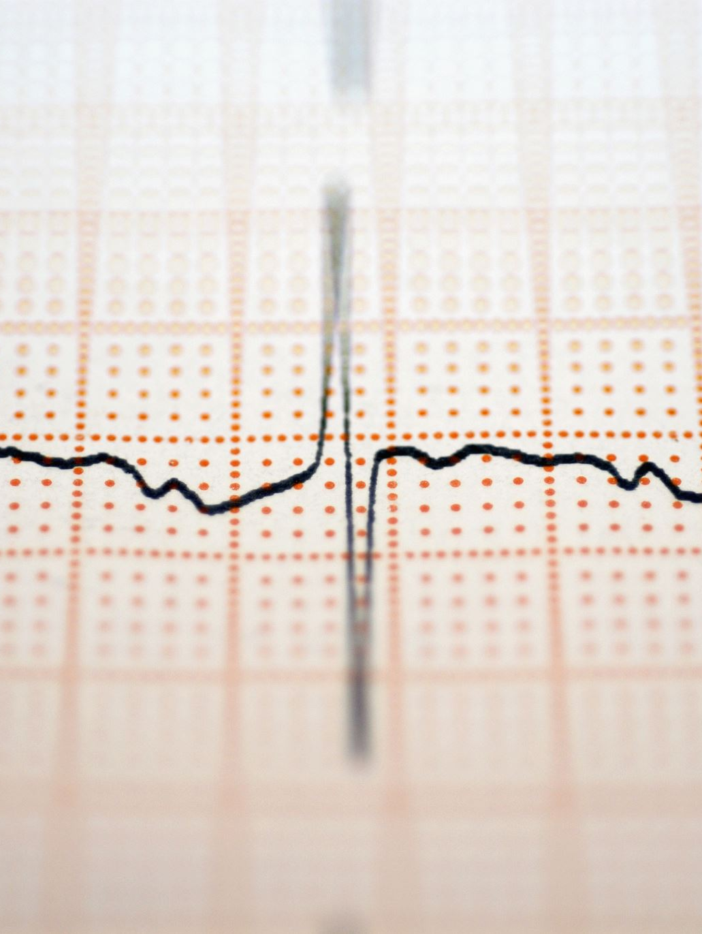
This work include three major subtask.
This work is similar as to IFCNN. To enhance the resultant image, first frequency domain method 1 dimensional discrete wavelet transform is used to convert the image into approximation part and the detail’s part and then CNN to merge the corresponding approximation and details part of two medical image. At last, by applying inverse dwt, we have obtained the result.

Slide 4
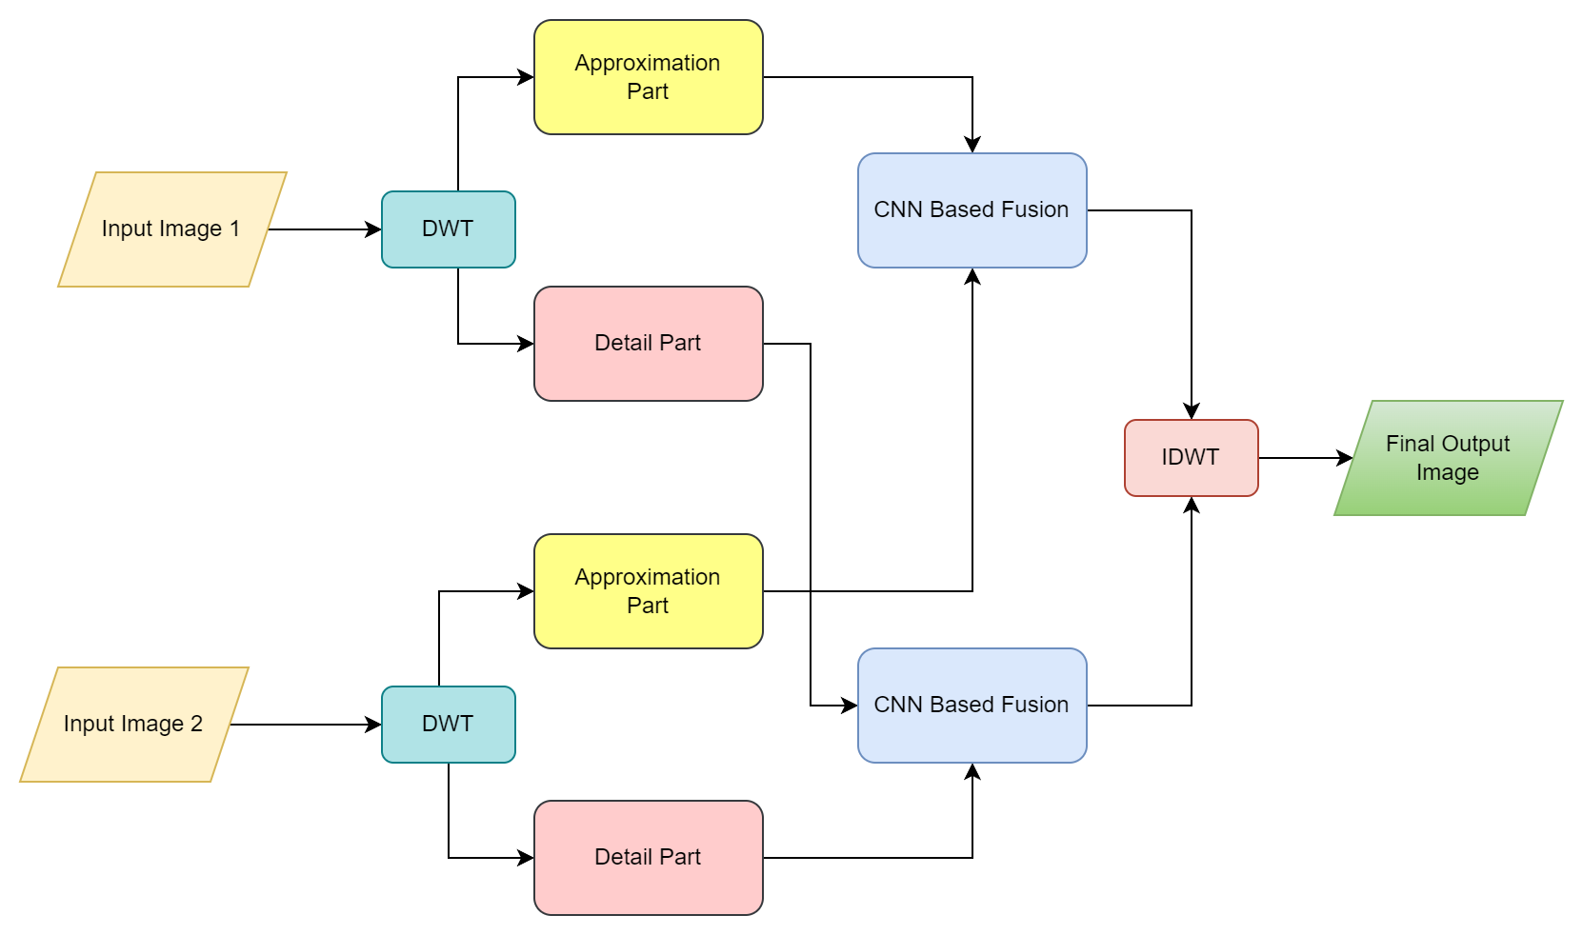
Methodology
Decomposition using DWT (Discrete Wavelet Transform)
Fusion using CNN
Feature Extraction
Feature Fusion
Obtaining Fused Image
Reconstruction Image using IDWT (Inverse DWT).

Slide 5
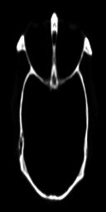
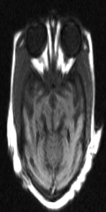
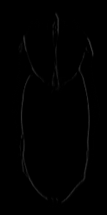
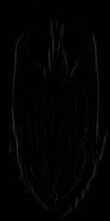
Image after applying DWT

Slide 6
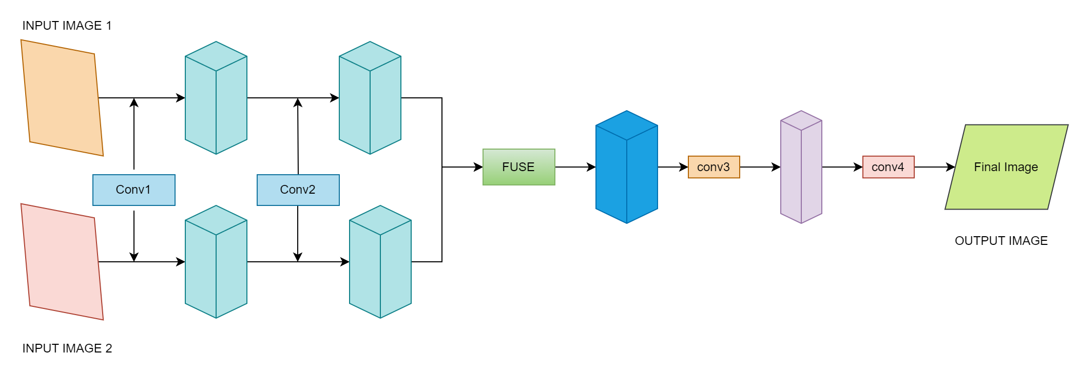
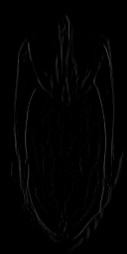
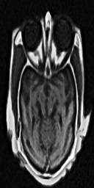
Fusion Using CNN

Slide 7
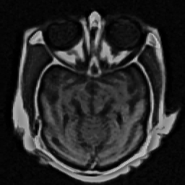
Results and Discussion
Result From Inverse DWT
The techniques used in this work provide overall good performance as it covers maximum details from the image to fuse image. The details of fuse image are different according to technique used for feature fusion.

Slide 8
Results and Discussion
As we have 3 fusion scheme available so there is some variety of results is obtained in each pictures In some cases max schemes cover more details than mean scheme and sum scheme. Also, there are cases in which mean, and sum schemes covers more details from both the input pictures. There are cases where each scheme provides almost the same details . So, there are dependency on fuse scheme which vary according the image, different image have given better results on different fusion schemes.

Slide 9
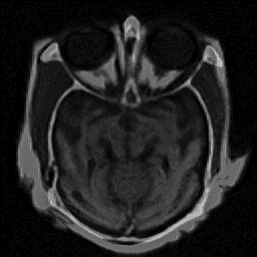
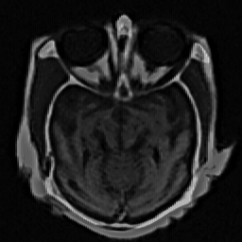
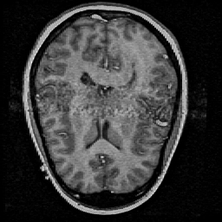
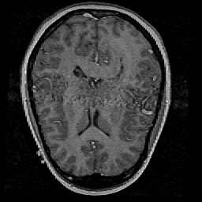
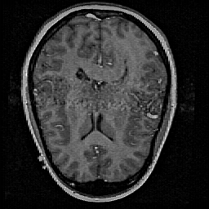
Results and Discussion

Slide 10
Conclusion and Future Work
The fusion method used in this work is very much effective and can be a powerful technique for enhancing and integrating information from multiple images. The reason behind its powerfulness is that it utilizes both DWT and CNN which make is more flexible and useful.
Some of the future scopes of this project are following –
NSDWT (Non-Sampled DWT) can be used.
Many different wavelets other than haar can be utilized for better results..
Different wavelets transform can also be used like CWT, FWT, SWT etc.
Further we can improve the network design with deeper and having attentive mechanisms.
Training data can also be varied we can scale this work by using more diverse data.
Different fusion mechanisms can be explored.

Slide 11

Thank You

